Slide 1

Case study: Lyka

Slide 2
Lyka is a multi-national beauty product company having 17 products in the portfolio
Lyka is selling its products through an online shopping platform
Some of the Lyka products are medicated and hence prescribed by physicians
Lyka’s senior management has asked ProcDNA team to create a PowerPoint based report highlighting various KPIs to track consumer behaviour and product performance
ProcDNA team has come up with different metrics that can be tracked. Please use the data file provided to you to answer the questions in the follow-up slides
Take relevant assumptions and feel free to do desk research, wherever required. Please add a slide on assumptions

Slide 3
1. Consumer reorder trend
Order Frequency | Number of Consumers | % of Total Consumers | Avg Days Between Orders
1 | 6858 | 51.58% | NA
2 and more | 6439 | 48.42% | 219.6241
3 and more | 3879 | 29.17% | 162.0292
4 and more | 2499 | 18.79% | 127.5561
5 and more | 1743 | 13.11% | 106.1839
6 and more | 1288 | 9.69% | 91.83463
7 and more | 1000 | 7.52% | 81.89952
8 and more | 787 | 5.92% | 73.93901
9 and more | 644 | 4.84% | 68.20425
10 and more | 521 | 3.92% | 62.92718
Here, we can clearly see a downward trend.
51% of consumers placing one order, As Order frequency is increasing the number of consumers got decreased.

Slide 4
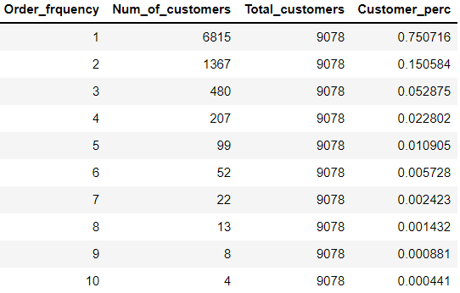
Create the same slide considering only 2019 data. Does the reorder trend remain the same?
Here we can clearly see a downward trend
75% of consumers placed 1 order. , As Order frequency is increasing the number of consumers got decreased.

Slide 5
What checks will you apply on the raw data as well as the output to ensure the data accuracy?
Ensure there is no duplicate
Remove irrelevant data
Convert data type
Need to do exploratory data analysis
Ensure to have, Total no of orders will be same in input data and output data
Ensure to have, Total no of unique orders across in input data and output data

Slide 6
2. Average Order Value (AOV) and Units / Order
Order Frequency | 1 | 1+ | 2+ | 3+ | 4+
Total Sales through these orders | 1486716 | 2711719 | 1959996 | 1462886 | 1087363
Total number of orders placed | 9356 | 13100 | 9030 | 6522 | 4762
Units of product ordered | 13986 | 24102 | 17195 | 12663 | 9341
Average Order Value (AOV) | 158.90 | 207.00 | 217.05 | 224.30 | 228.34
Units/Order | 1.49 | 1.83 | 1.90 | 1.94 | 1.96
AOV metric helps to understand sales growth as consumers place repeat orders
Here we can observe Average Order Value is increasing

Slide 7
Average Order Value (AOV) and Units / Order
O Create the same slide considering only 2019 data. Is there a drop in AOV for any order frequency O
Order Frequency | 1 | 1+ | 2+ | 3+ | 4+
Total Sales through these orders | 1398225 | 1839565 | 1103007 | 678022 | 418991
Total number of orders placed | 8399 | 8490 | 4897 | 2967 | 1844
Units of product ordered | 13226 | 16158 | 9571 | 5886 | 3614
Average Order Value (AOV) | 166.47 | 216.67 | 225.24 | 228.52 | 227.21
Units/Order | 1.57 | 1.90 | 1.95 | 1.98 | 1.95
In 2019 we can observe Average Order value is increased for order frequency

Slide 8
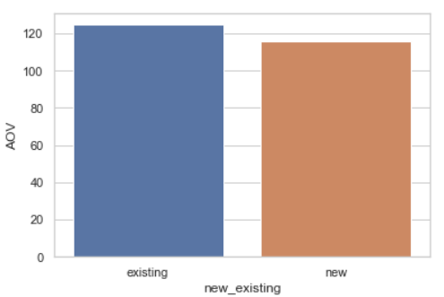
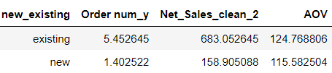
3. Consumer growth drivers
What is more valuable for Lyka – adding more new customers or maintaining the existing customers? Why?
maintaining the existing customers is more valuable for Lyka.
when we compare both Average order value of existing and new customers more orders done my Existing customers
Acquiring a new customer can cost five times more than retaining an existing customer. Increasing customer retention by 5% can increase profits from 25-95%. The success rate of selling to a customer you already have is 60-70%, while the success rate of selling to a new customer is 5-20%.

Slide 9
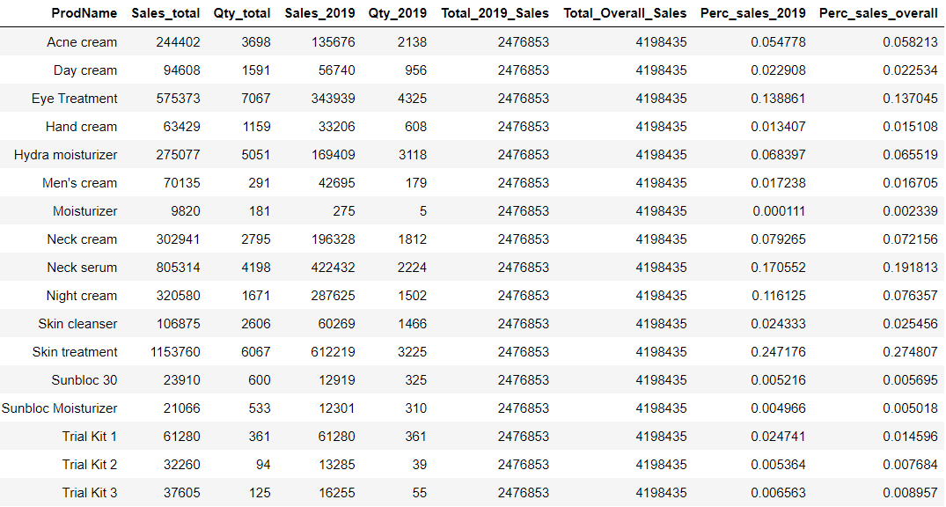
The sales by each product in two time periods (i) Complete data (ii) 2019 data

Slide 10
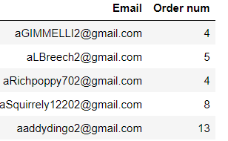
5. Product reorder trends
(i)Which are the top 5 products?
- The top 5 products are Skin treatment ,Neck serum ,Eye Treatment ,Night cream ,Neck cream
(ii)How many would be consumers ordered all the 5 products?
- 65 unique customers ordered all 5 products
(iii)Number of orders required by these customers to purchase all 5 products
- Here, In order to buy all five products, the first person needs to place four orders, as can be seen.
(iv)Product with the highest repurchase rate
- Here, we can see that Skin Treatment has the highest repurchase rate i.e. 30%

Slide 11
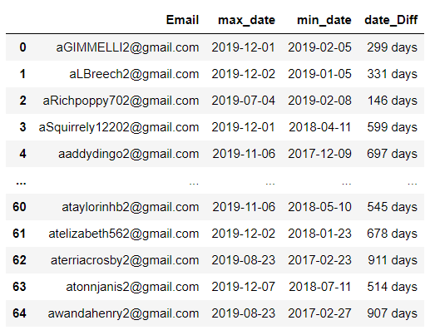
How long do customers take to buy the portfolio of these top 5 products? (in terms of days/years)
1st Customers take 299 days to purchase the portfolio of these top 5 products
^{2nd} Customers take 331 days to purchase the portfolio of these top 5 products
^{3rd} Customers take 146 days to purchase the portfolio of these top 5 products

Slide 12
Can you create a short summary which can be shared with the product managers?
In the net sales column, we have the total sales, some of which are negative values .I cleaned the sales column first.
In the consumer reorder trend, we can see that while order frequency increases, the overall number of consumers decreased.
When we compare 2019 data with complete consumer reorder trend data these things we can observe.
In the whole data, we can see that 51% of consumers placed one order, whereas in the 2019 data, 75% of consumers placed their first order.
Average order value metric helps to understand sales growth as consumers place repeat orders.
We can see that the Average Order Value is increasing .
when we compare both Average order value of existing and new customers more orders done my Existing customers.
Skin treatment, neck serum, eye treatment, night cream, and neck cream are the top 5 items.65 unique customers ordered all 5 products.
In this case, Skin Treatment has the highest rate of repurchase 30%.
Customers purchase the portfolio of these top 5 products in 299–331 days.

Slide 13
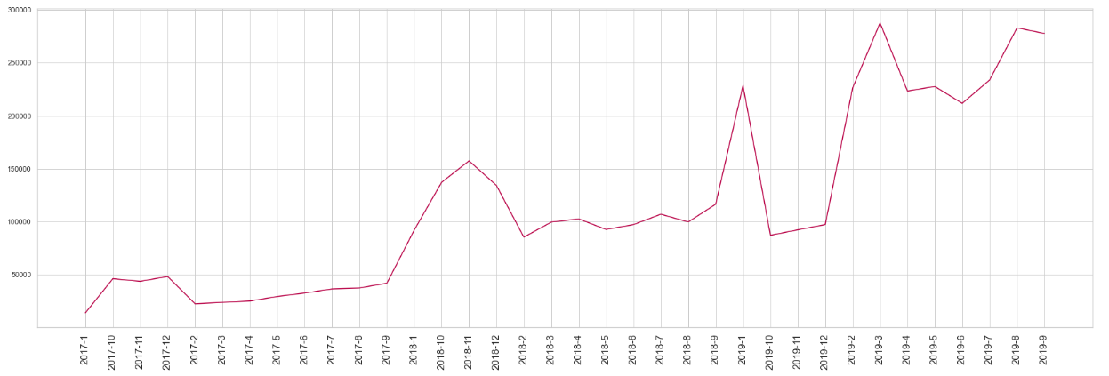
6. Sales performance
Graph showing month over month sales and number of unique consumers

Slide 14
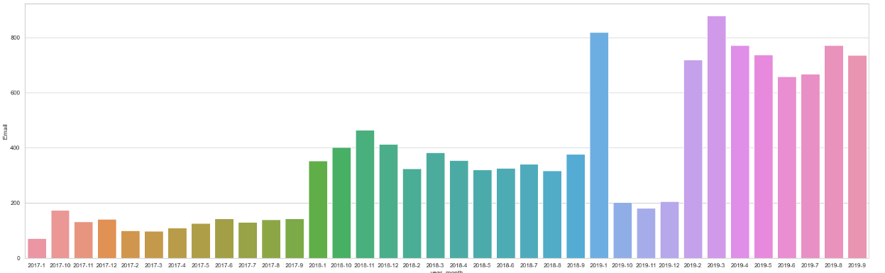
As we can see every month new customers being added each month

